Slide 1
ESDM team-1
Harsha V Vardhan | Suman M K | Sriram B Joshi
Siddalingeshwar S R

Slide 2
Problem Statement
Ksens Node and Gateway: To design and implement smart water management system that automates the flow of water which ensures the efficient distribution and judicious usage of water by using valves and sensors.

Slide 3
Objectives
To reduce cost by reducing hardware complexity by reducing hardware components wherever possible.
To further increase power efficiency of the node by optimization methods.

Slide 4
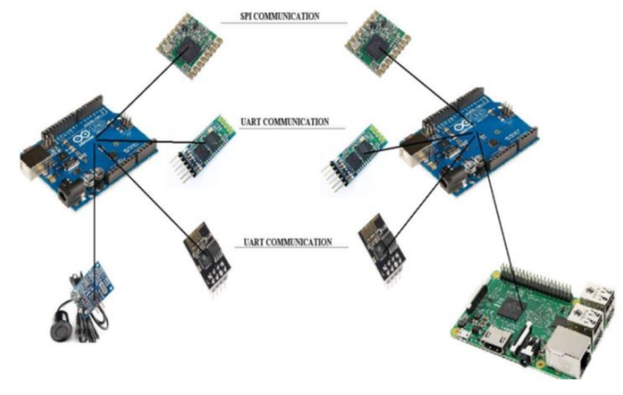
Existing architecture

Slide 5
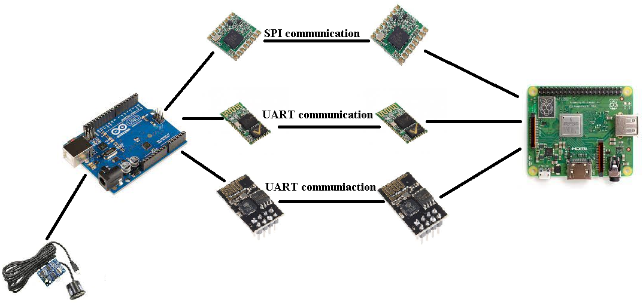
planned Architecture

Slide 6
Status
Searched for documentations and python libraries for all the hardware modules being used.
Conducted experiments on different modes of connectivity between Arduino and Raspberry-pi using different communication protocols.
Bluetooth was bound using AT commands on both Arduino and Raspberry-pi ends.
Looking into MQTT protocol for esp8266 communication.
Radio libraries are being integrated with Raspberry-pi on gateway end.
Surveying about low power GSM modules for GSM communication.

Slide 7
Thank you

